Slide 1


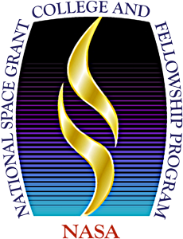
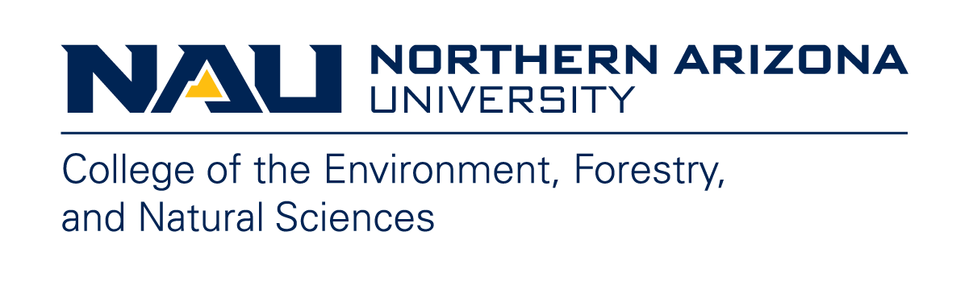

Space Weathering of Dark Regolith and Carbonaceous Asteroids
Emily Clark
Mentor: Dr. Mark Loeffler
School: Northern Arizona University
Arizona NASA Space Grant Statewide Student Research Symposium
Arizona State University
April 19, 2025

Slide 2
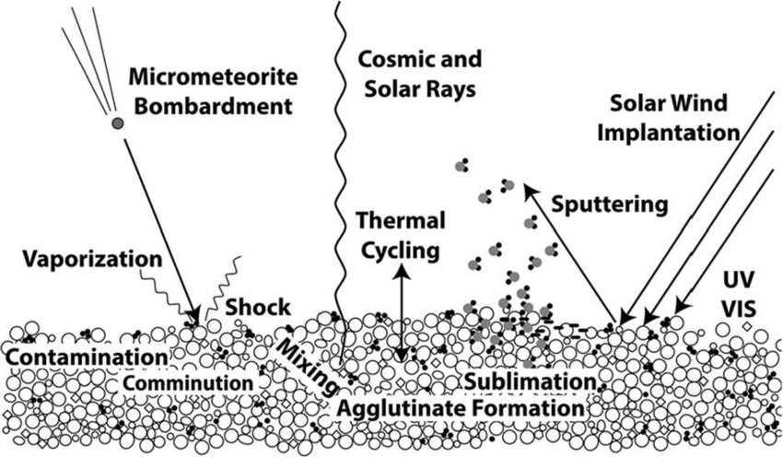
Background
Bodies without atmospheres are weathered by
  Micrometeorite Bombardment
  Cosmic Rays
  Solar Wind
Lab experiments help us understand spectra of various materials for comparison to remote sensing observations
Pieters & Noble 2016

Slide 3
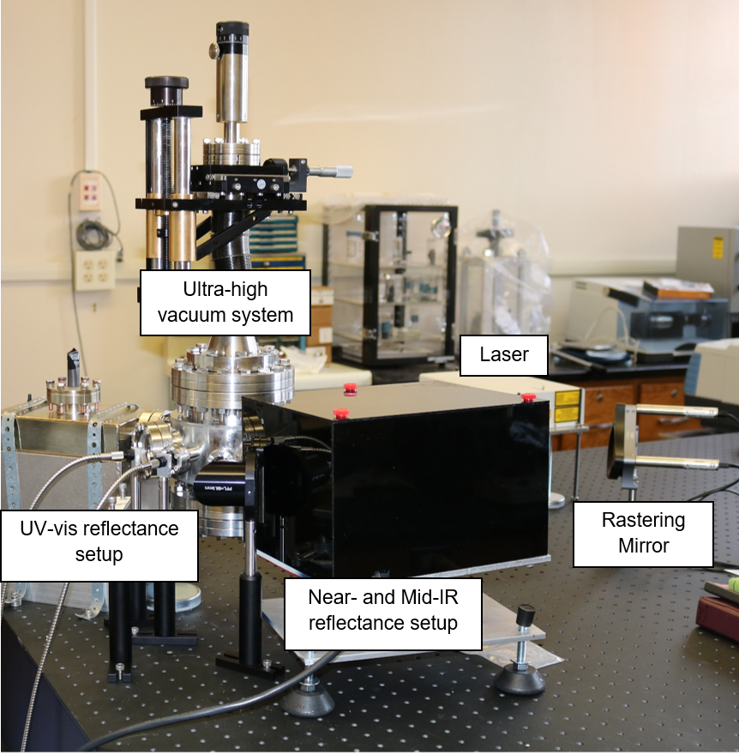
Methods
Prepared pressed pellets of magnetite and CI simulant
  < 45 µm grain size
  11000 lbs of force
  ~5 min
Characterized initial reflectance spectra
  Ultraviolet-visible (UV-Vis) (0.25-0.9 µm)
  Near infrared (NIR) (0.75-2.5 µm)
Ultra-high vacuum system
  ~10⁻⁸ Torr
Loeffler 2018

Slide 4
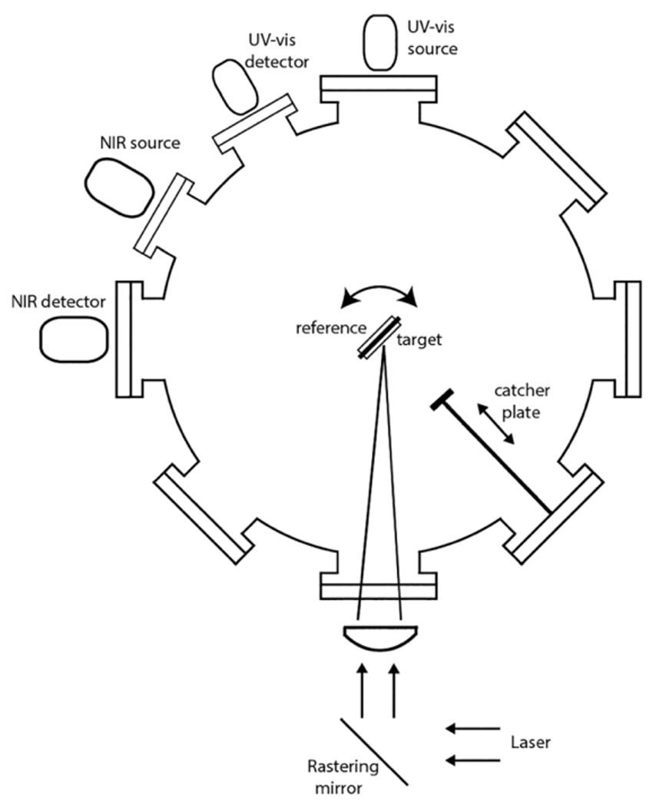
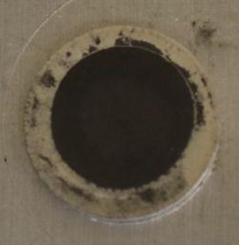
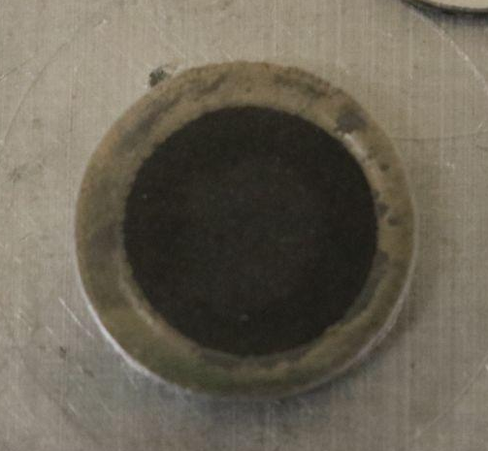
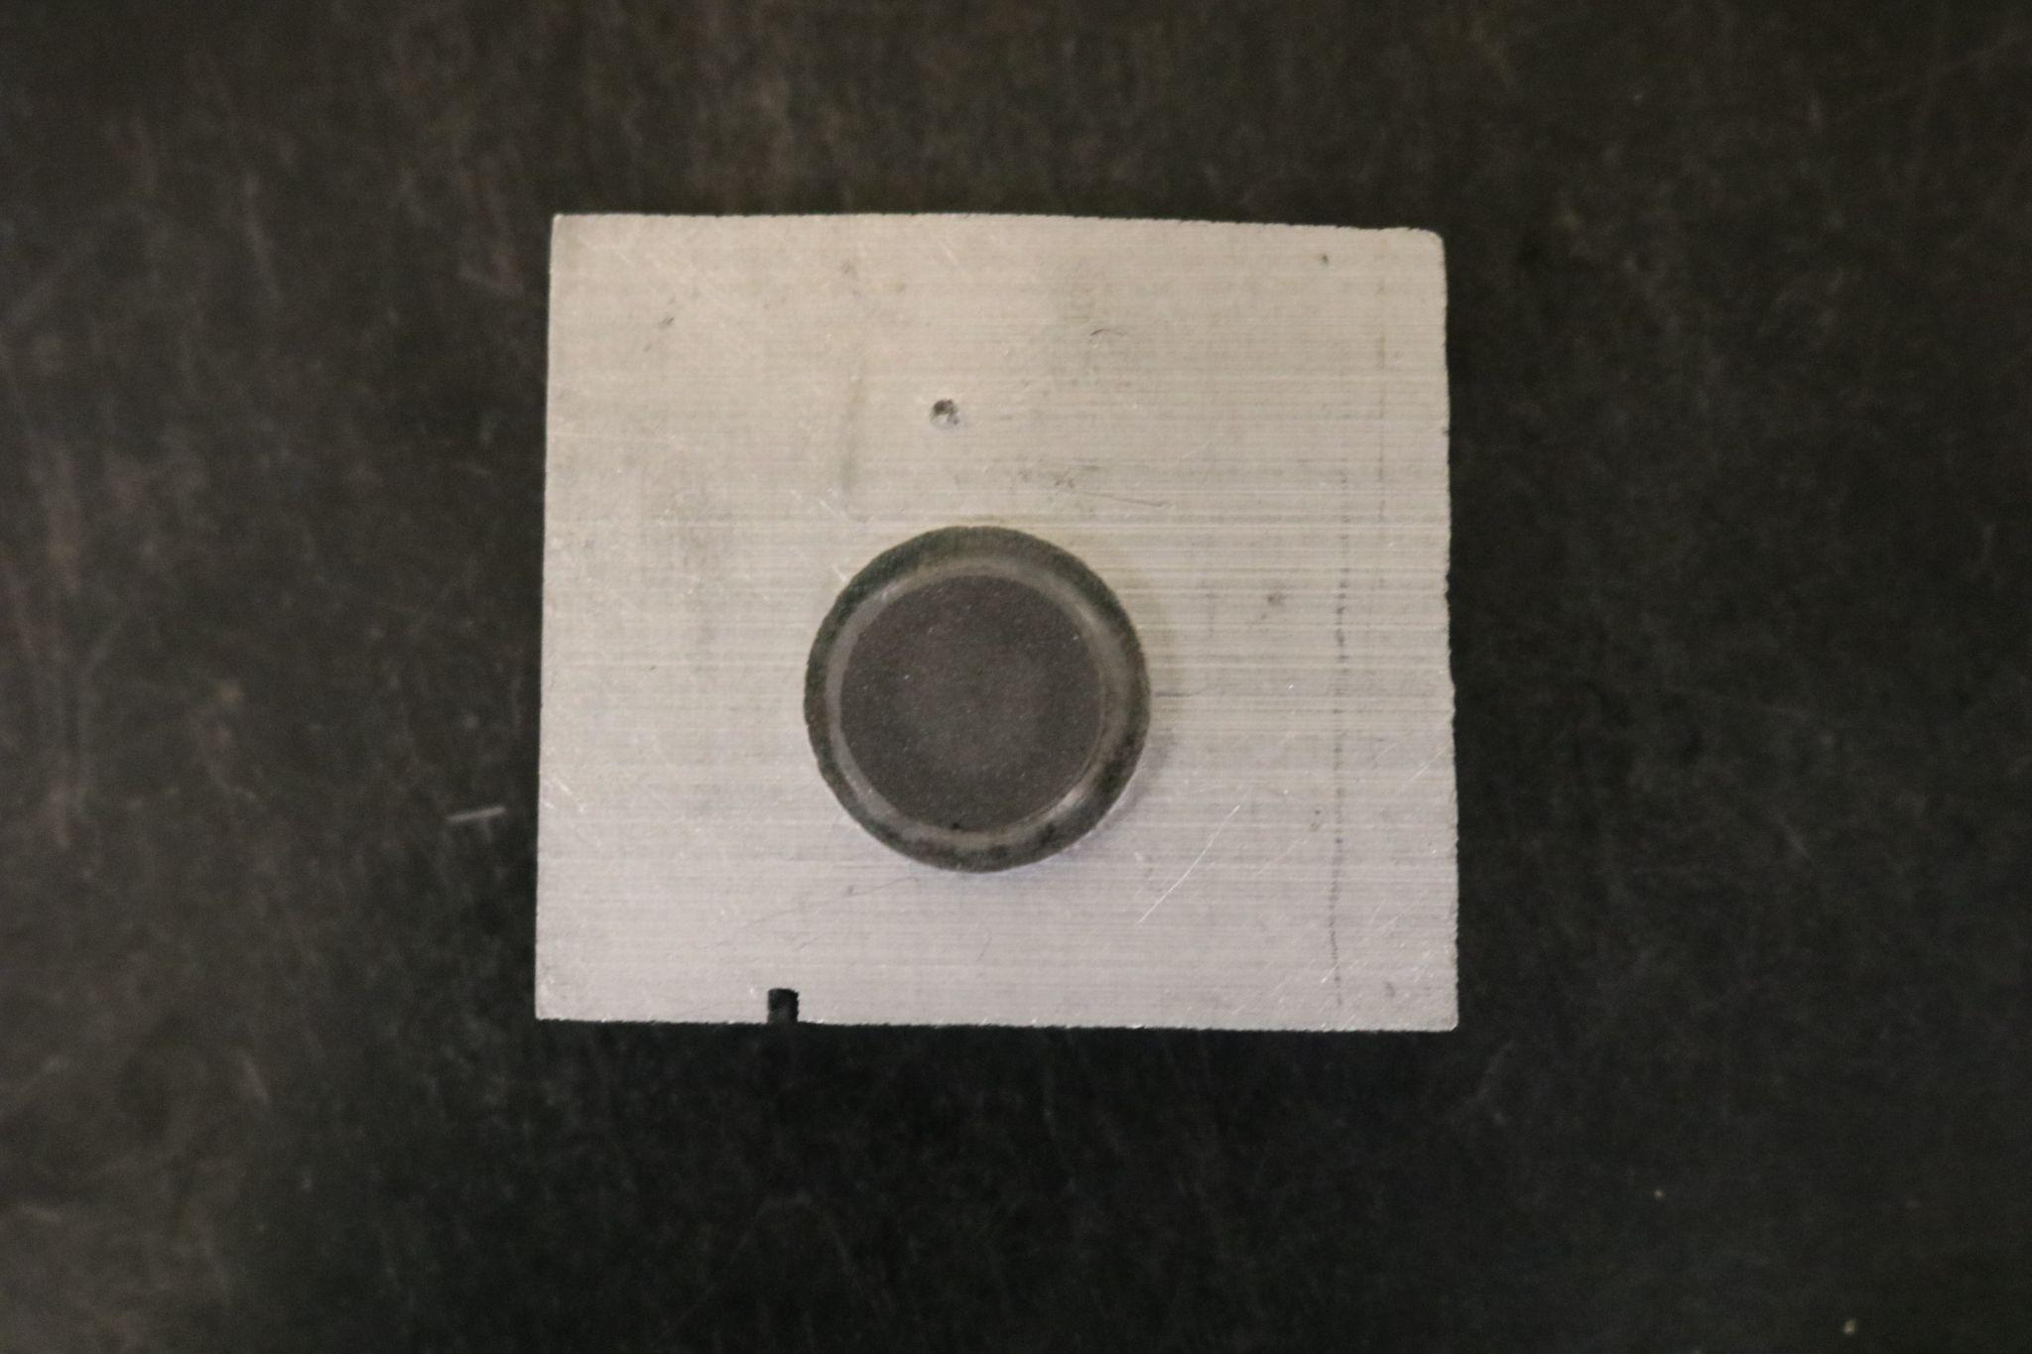
Methods
Ablated iron with a pulsed laser
  ~40 mJ per pulse
  Ablated material gets deposited onto sample
Removed samples at pre-specified intervals of iron deposit thickness to perform reflectance spectroscopy
Loeffler
fresh
10 nm
15 nm

Slide 5
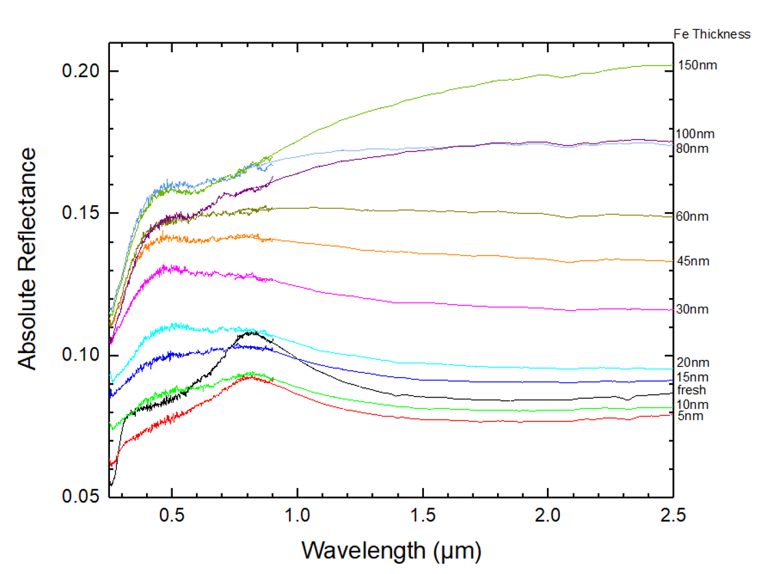
Previous Work
CI Simulant Sample
UV-Vis and NIR reflectance spectra as a function of Fe deposit thickness
  Reflectance initially decreases and subsequently increases
  Attenuation of absorption band
    Begins to mimic Fe
Clark

Slide 6
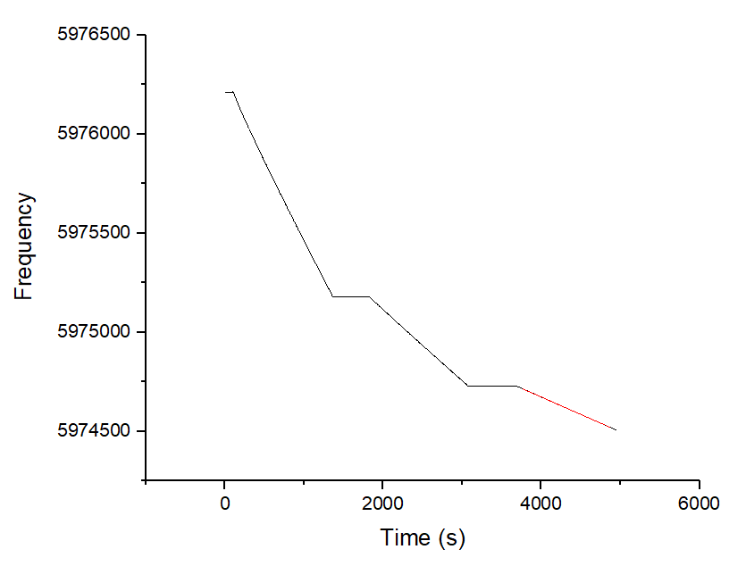
A Lesson in Troubleshooting
This experiment requires QCM calibration
Here is what we expect to get:
4 Hz
2 Hz
1 Hz
Clark

Slide 7
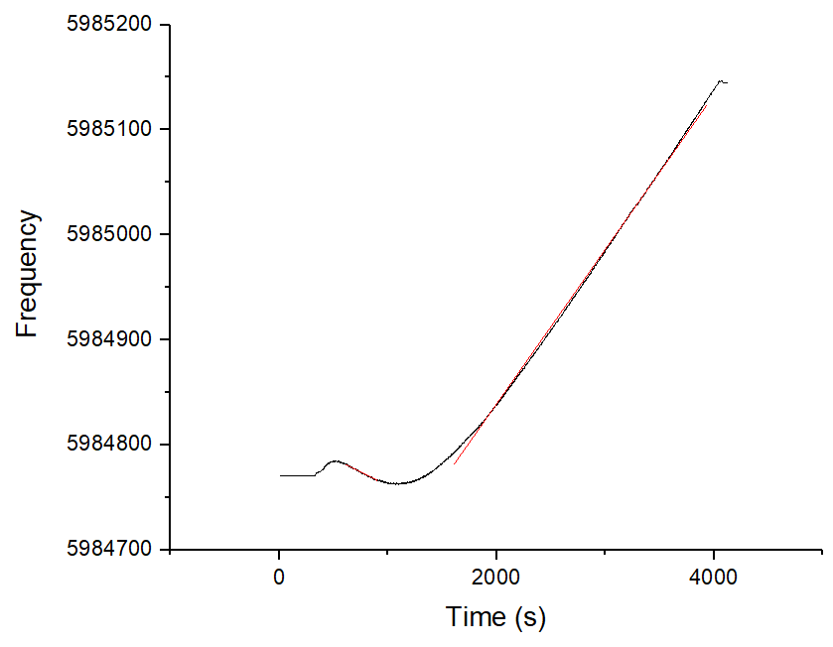
A Lesson in Troubleshooting
This experiment requires QCM calibration
Here is what I kept measuring:
We still don’t know what caused this!
Clark

Slide 8
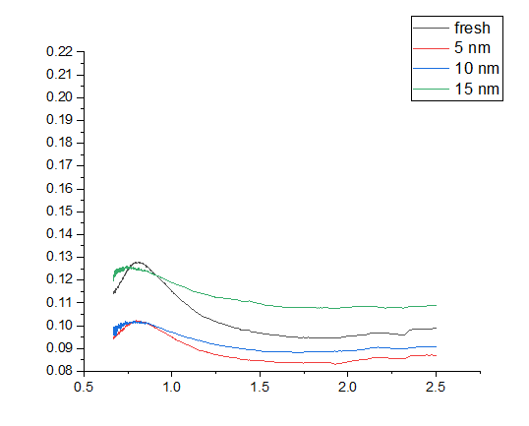
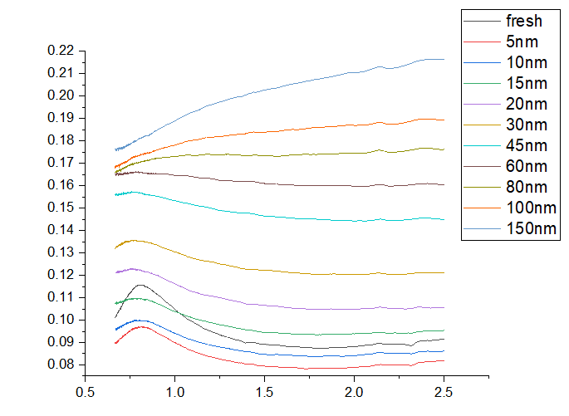
Results - This Year vs Last Year - IR
*This is RAW DATA and conclusions should not be drawn from it*
But, we can see that similar trends are beginning to emerge

Slide 9
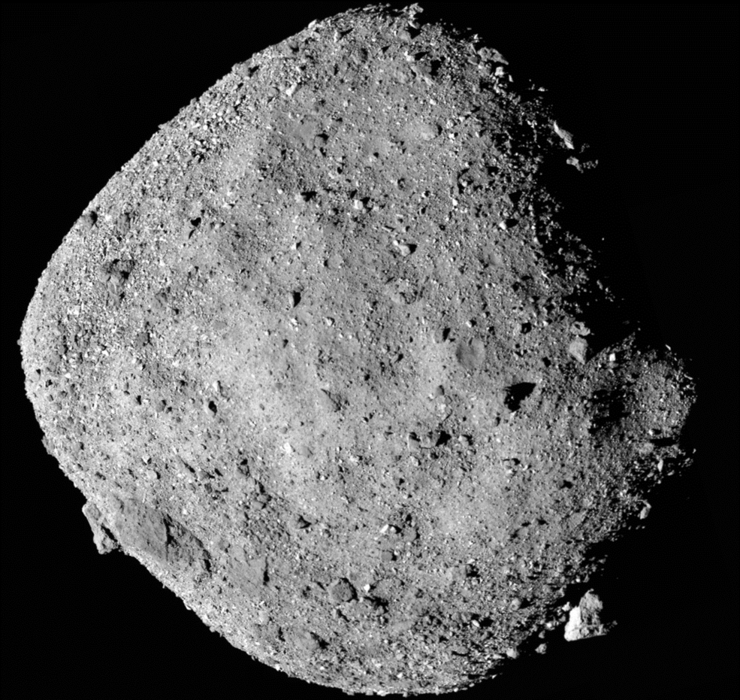
Conclusions
Depositing metallic Fe on dark materials generally causes an increase in reflectance
Spectral slope generally reddens with more Fe
  Consistent with brighter silicates
Experimental work is tricky and can sometimes take longer than planned!
NASA 2020

Slide 10
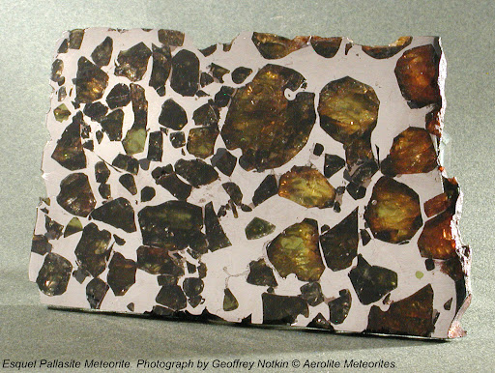
Future Work
Finish CI simulant experiments
Repeat procedure with bright material
  Olivine
  Also important component of asteroids
Ultimately, compare to remote sensing observations
Goldstein 2010

Slide 11
Thank You
Acknowledgements: Special thank you to Dr. Mark Loeffler and AZ Space Grant!

